Slide 1

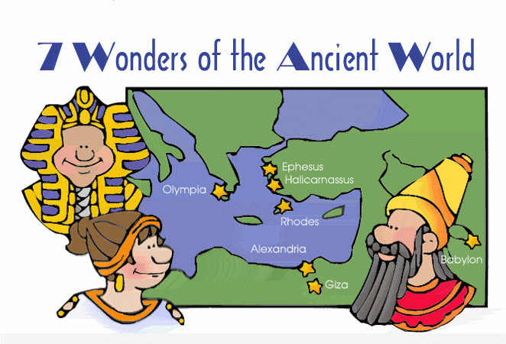
Visit the Seven Wonders of the Ancient World
Great Pyramid at Giza
Hanging Gardens of Babylon
Statue of Zeus at Olympia
Temple of Artemis at Ephesus
Mausoleum at Halicarnassus
Colossus of Rhodes
Lighthouse at Alexandria

